Slide 1
Peacebuilding:
What, Why and How?
Judy Cheng-Hopkins
United Nations Assistant Secretary-General
for Peacebuilding Support
UPEACE The Hague, 7 March 2014

Slide 2
Introduction
Peacebuilding in the UN context
Why is it important and what does it consist of?
The missing link?

Slide 3


            Stages of UN involvement in post-conflict countries
            _{WAR}
            SUSTAINABLE
            PEACE
            Humanitarian
            Asst.
            Peace
            making
            (Mediation)
            Peace
            keeping
            Peace
            building
            Development
            PB important to prevent relapse and failed states

Slide 4
Peacekeeping vs peacebuilding
Peacekeeping:
  ‘Blue helmets’ to help stabilize conflict areas
  Some integration with wider UN efforts to revitalize economies
  15 peacekeeping missions, 13 ‘special political missions,’ envoys and special advisers
Peacebuilding:
  Build longer-term sustainable peace and stability
  Lay foundations for economic recovery and development
  Build institutions, infrastructures and capacities
  Overcome legacies and root causes of conflict

Slide 5
Why is Peacebuilding Important?

Slide 6
Less war, fewer coups, more democracy
Democracies | 1946: 20 | Now: close to 100
Authoritarian regimes | 1976: almost 90 | Now: 25
Latin America | 1970-1989: 30 coups d’etat | Since 1990: 3 coups d’etat
Africa | 1970-1989: 99 coups d’etat | 1990-2010: 67 coups d’etat
Conflict | 1992: 21 countries involved in inter-state and civil conflict | 2011: 7 countries involved in inter-state and civil conflict
Source: Centre for Humanitarian Dialogue
Notes:
These figures are from 2011 and don’t really include the Arab Spring and its ramifications – which are still playing out.
The overall picture , however, won’t be changed completely, even if individual figures change a little…
Overall, there has been a reduction in the prevalence of violent conflict and illegitimate changes of government

Slide 7
But the problem of state fragility persists
Conflict and war occur in countries that have previously experienced civil war: Relapse into violence in countries that have poor governance, weak institutions, high insecurity. Some decades long.
They matter because they provide safe havens for terrorists (Afghanistan, Mali, Somalia, Yemen), are major sources of drug trafficking (Guinea-Bissau, Honduras) and other ills.

Slide 8
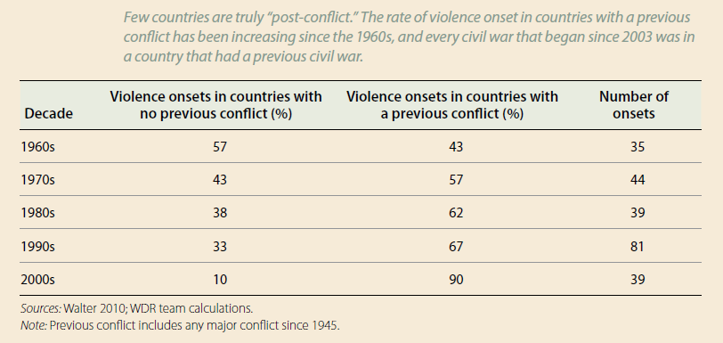
Violent conflict often recurs
The World Bank, World Development Report 2011: Conflict, Security, and Development, Table F1.1
Notes:
Focus on the 10% and 90%!

Slide 9
Violence disrupts development
1.5 billion people live with violence and conflict
42 million people are displaced as result
Poverty is 20% higher in conflict countries
Countries with negligible or no violence - major decline in poverty between 1981 and 2005; in conflict-affected countries, poverty remained constant over the same period. Most post conflict countries have not achieved a single MDG!

Slide 10
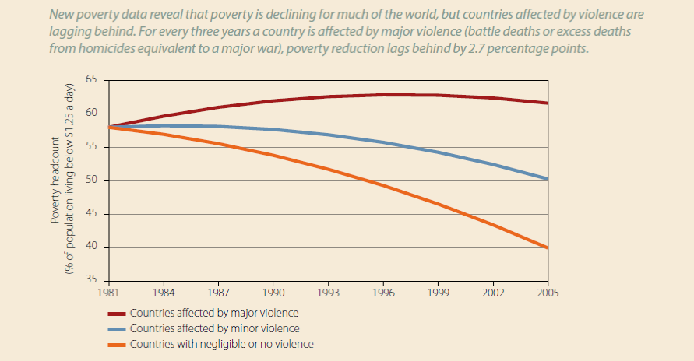
Violence slows decline in poverty
The World Bank, World Development Report 2011: Conflict, Security, and Development, Figure F1.3

Slide 11
A typical post-conflict country…
“Ordinary” development challenges compounded by
  Decades of intermittent civil war, with relapses into violence
  Military domination and/or coups
  Wealth in natural resources but steep divide between small rich elite and poor majority of the population (relapse into conflict 50% more likely in natural resource-rich countries)
  Land issues are often key drivers of conflict
  Weak institutions and public services
  High prevalence of corruption, limited or no rule of law and limited or no accountability and transparency
  “Vicious cycle of idle youth”

Slide 12
What is Peacebuilding?

Slide 13
Peacebuilding is a schlep
S | Safety and human security | Security sector reform (SSR), disarmament, demobilisation and reintegration (DDR), Rule of law, human rights…
C | Civil society | Civil society mobilisation and civic education, civilian oversight of army
H | Healing | Reconciliation, mediation, transitional justice, protection, psychosocial therapy, IDPs and returnees/integration, SGBV, reparations
L | Livelihoods | Job creation, short-term employment generation, youth, public works
E | Empowerment of women and youth | Restarting economic activities, resettlement and shelter, land reforms, natural resources,
P | Public administration and accountability | Re-establishing state authority, basic services provisions, institutions and local governance, constitutional reform, electoral reform processes, civil service reform, public finance management

Slide 14
Root causes and solutions
Simmering hatred, ethnic divisions |  | National Dialogue, reconciliation
Lack of understanding of democratic norms and practices |  | Civic education
Sense of injustice and inequality |  | Rule of law, anti-corruption, human rights
Military dominance |  | Security Sector Reform (SSR)
Lack of civilian oversight and accountability |  | Rule of law, institution-building
Former combatants left to their own devices |  | Disarmament, demobilization and reintegration (DDR)
Poverty and lack of livelihoods |  | Public service delivery, employment creation, peace dividends

Slide 15
How?

Slide 16
The UN peacebuilding architecture
Established in 2005
Three pillars:
  Peacebuilding Commission
  Peacebuilding Fund
  Peacebuilding Support Office

Slide 17
Peacebuilding strategic entry points
Avoiding relapse into violence (Guinea)
Protecting peacekeeping investments (Liberia, Sierra Leone)
Quick statebuilding (Yemen)
Supporting UN leadership for rapid response; deteriorating situations (Sierra Leone)
Accompaniment: stay the course for peace (Burundi)

Slide 18
The missing link!

Slide 19
Women are the ultimate victims of conflict…
Family rupture
Change of roles:
  33% of households in Rwanda headed by women in 2010.
  28% of households in Nepal headed by women in 2011.
Sexual violence:
  DRC: 200,000 women and children raped over a decade.
  Sierra Leone: 64,000 incidents of war-related sexual violence 1991-2001.
  Source: UN Action Against Sexual Violence in Conflict

Slide 20
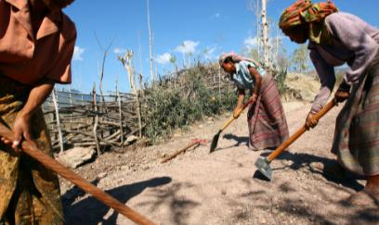
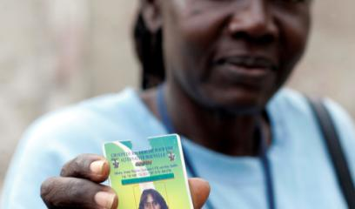
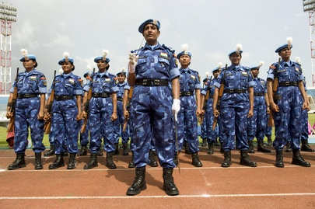
… but also the ultimate “agents of change”
Women are solely responsible for 80% of food crops in developing countries, yet less than 10% of landholders are women in Western, Central and North Africa (FAO)
Most women spend their income to meet the needs of their family and household – education, health, nutrition
Women play peacebuilding roles daily, typically at grassroots level - e.g. Acholi women groups vis-à-vis the LRA in Northern Uganda
Women parliamentarians tend to emphasize issues such as physical safety and gender-based violence, human development, poverty and the delivery of services (IPU)

Slide 21
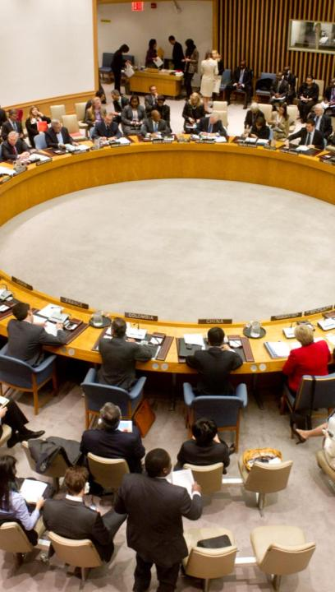
Evolution of normative framework
SCR 1325 (2000): First to link women’s experiences of conflict to the maintenance of international peace and security.
SCR 1820 (2008), 1888 (2009), 1960 (2010) and 2106 (2013) on conflict-related sexual violence
SCR 1889 (2009): Addresses women’s exclusion from early recovery and peacebuilding and lack of adequate planning and funding for their needs.
SCR 2122 (2013): Emphasizes women’s participation in conflict resolution and recovery and requests global study on 1325 by 2015.
Notes:
SCR 1325 (2000): First resolution to link women’s experiences of conflict to the maintenance of international peace and security.
SCR 1820 (2008): First to recognize conflict-related sexual violence as a tactic of warfare and a critical component of the maintenance of international peace and security.
SCR1888 (2009): Strengthens tools for implementing 1820 through assigning leadership, building judicial response expertise, and reporting mechanisms
SCR1960 (2010): Provides an accountability system for addressing conflict-related sexual violence
SCR 2106 (2013): defines a multi-dimensional framework for prevention and calls for peace agreements, cease-fires, SSR and DDR processes to explicitly take into account sexual violence.
SCR 1889 (2009): Addresses women’s exclusion from early recovery and peacebuilding and lack of adequate planning and funding for their needs.
SCR 2122 (2013): Grounds the call for women’s participation in conflict resolution and recovery in specific actions for UN envoys and leaders in conflict and mission contexts and in relevant UN entities, including DPA, DPKO, and UN Women. Also requests the Secretary-General to produce a global study on the implementation of SCR 1325 by 2015

Slide 22
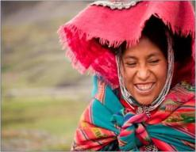
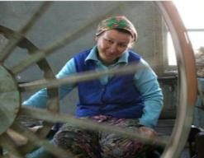
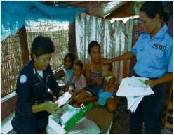
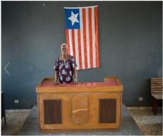
The UN’s 7-Point Action Plan (7PAP)
on gender-responsive peacebuilding (2010):
Conflict resolution
Post-conflict planning
Post-conflict financing
Civilian capacity
Participation in Public life (30%)
Rule of law
Economic recovery
The Secretary-General has identified
the implementation of the Action Plan
as a priority for his second term.

Slide 23
Peacebuilding’s in-built bias
Typical peacebuilding activities - SSR, DDR, national dialogue, public administration reform, etc. - all have men as main target.
Women are not the ones causing conflict, not the ones causing a relapse into conflict – so peacebuilding is inherently targeting men.
Need to expand our peacebuilding paradigm to change this in-built bias against women because invaluable role they play.
Notes:
It’s almost like blackmail – men cause relapse, so they are the targets of peacebuilding interventions

Slide 24
Towards a new paradigm
Four necessary changes to shift the paradigm:
Pre-investment: View women’s economic empowerment as a pre-investment for peacebuilding, leadership roles etc.
Who can do the job: Start with available capacity of implementing partners
“Quotas+”: Quotas need to be supplemented by efforts to build capacity
Innovation: Support innovative projects and learn from them
Start with women’s empowerment as sine qua non!

Slide 25
Women’s innate interest for peace
"We are tired of war. We are tired of running. We are tired of begging for bulgur wheat. We are tired of our children being raped. We are now taking this stand, to secure the future of our children. Because we believe, as custodians of society, tomorrow our children will ask us, ‘Mama, what was your role during the crisis?’” Leymah Gbowee, Liberia, at a hearing with Charles Taylor, April 2003.
Women are everyday peacebuilders!

Slide 26
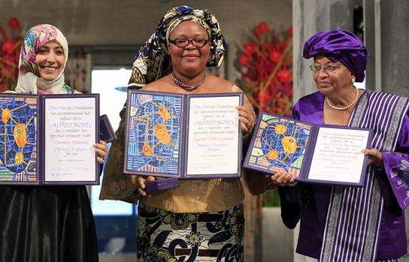
Nobel Peace Prize (2011)

Slide 27
Women in parliaments post-conflict, first and recent elections
WITH QUOTAS
women’s participation in parliaments post-conflict is much higher:
1st election: 21% vs 7%
Last election: 30% vs 7.3%

Slide 28
When women are elected…
Rwanda: 64% women in parliament (#1 worldwide). 2012 land reform:
  11% of the land is owned by women
  83% of the land is joint-owned by married couples
  6% of the land is owned by men
Burundi: 30% women in parliament collectively pushed for reform of the penal code to include definition of sexual violence

Slide 29
Implementation Challenges
Evidence base is weak – because programmatic base is weak!
Trends of pet themes, stand alone projects, or “adding women in”
Need for greater operational learning to understand what works. Need to include gender in any conflict analysis and in strategic planning at country level
Capacities: often limited – both UN and national. Combined expertise is required (rule of law + women’s rights; economic recovery + special sectors)
Lack of leadership/political support

Slide 30
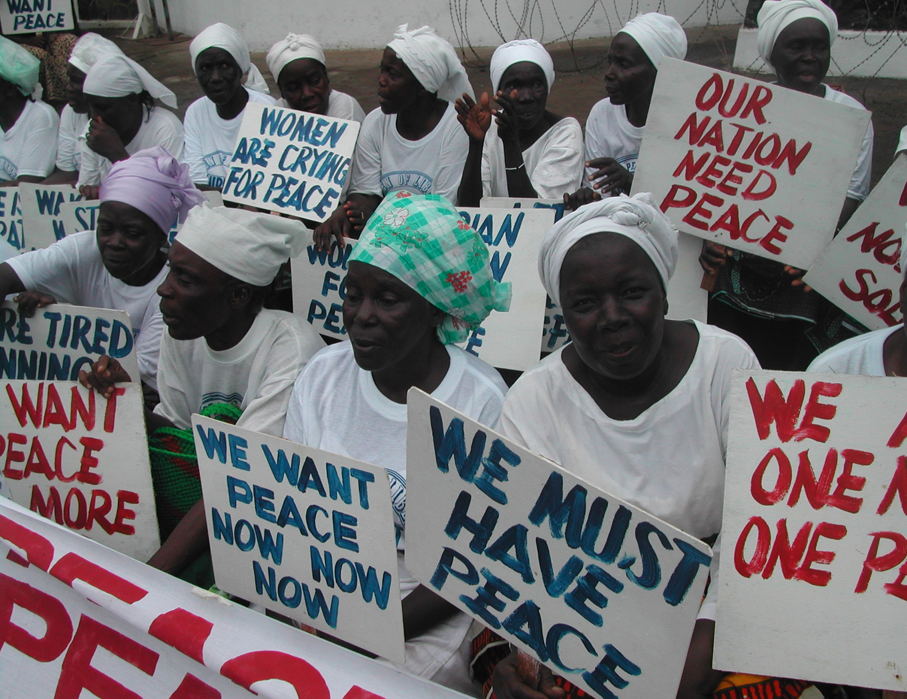
Thank you

